Slide 1

IMAGE SHARPENING

Slide 2
Sharpening spatial filters
Image sharpening filters highlight the details of an image.
High spatial frequency components have detailed information in the form of edges and boundaries.
Image sharpening algorithms are used to separate object outlines.
Therefore image sharpening filters are also know as edge enhancement

Slide 3
Blurring vs sharpening
Blurring / smooth is done in spatial domain by pixel averaging in a neighbours, it is a process of integration.
Sharpening is an inverse process , to find the difference by the neighborhood , done by spatial differentiation .

Slide 4
Derivative operator
The operator calculates the gradient of the image intensity at each point giving direction of the largest possible increase from light to dark and rate of change in that direction.
Image differentiation :
Enhances edges and other discontinuities (noise).

Slide 5
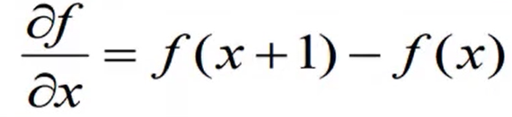
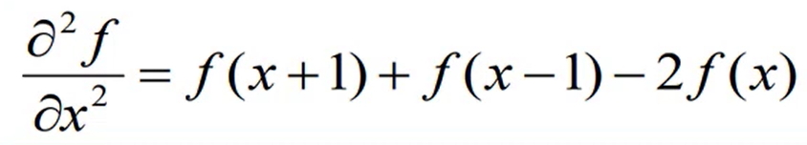
Foundation of sharpening spatial filters
The basic definition of first order derivative of a one dimensional function f(x) is the difference.
The second order derivative of a one dimensional function f(x) is the difference

Slide 6
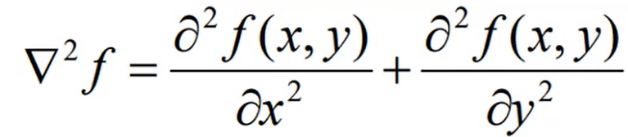
First & second-order derivative of 2d
Let us consider an image function of two variables, f(x,y) , at which time it will be dealed with partial derivatives along the two spatial axes.
Laplacian operator

Slide 7
Laplacian filer
It highlights grey-level discontinuities in an image.
It deemphasizes region with slowly varying gray levels.

Slide 8
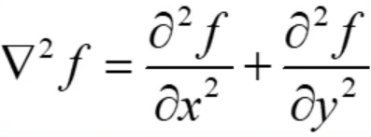
Laplacian filer
Isotropic Filter: Isotropic filters are those filters whose response is independent of the direction of the discontinuities in the image to which the filter is applied. In other words, isotropic filters are rotation invariant in the sense that rotating the image and then applying the filters gives the same result as applying the filter to the image first and then rotating the results.
The second order isotropic derative operator is the Laplacian for a function image f(x,y).

Slide 9
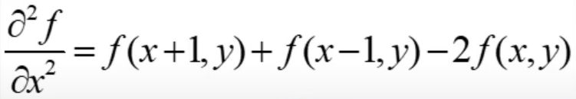
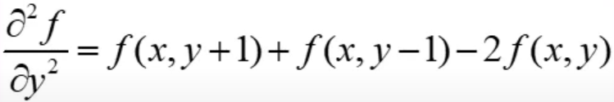
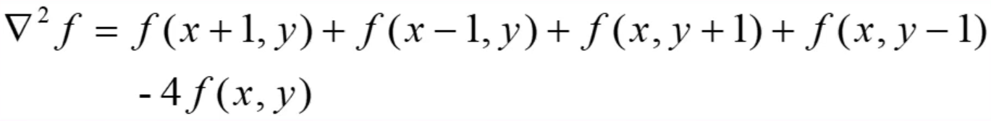
Laplacian filer

Slide 10
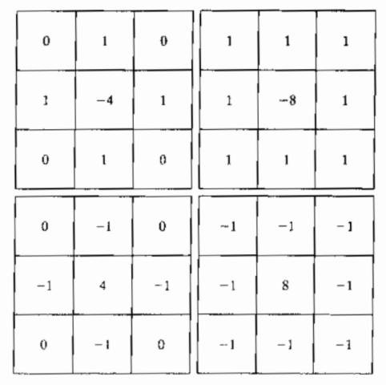
Sample Laplacian mask

Slide 11
Laplacian filer
Image enhancement of an image f(x,y) can be done by adding the Laplacian edge result.
It enhances the high frequency contents and thereby gives an edge enhancement image
The effect is simply obtained by adding the Laplacian image to the original.

Slide 12
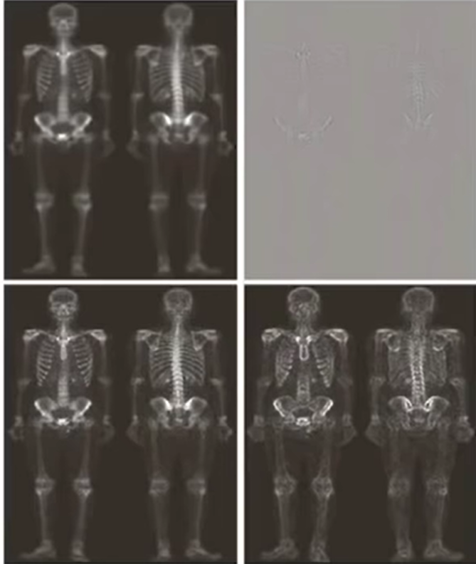

Slide 13
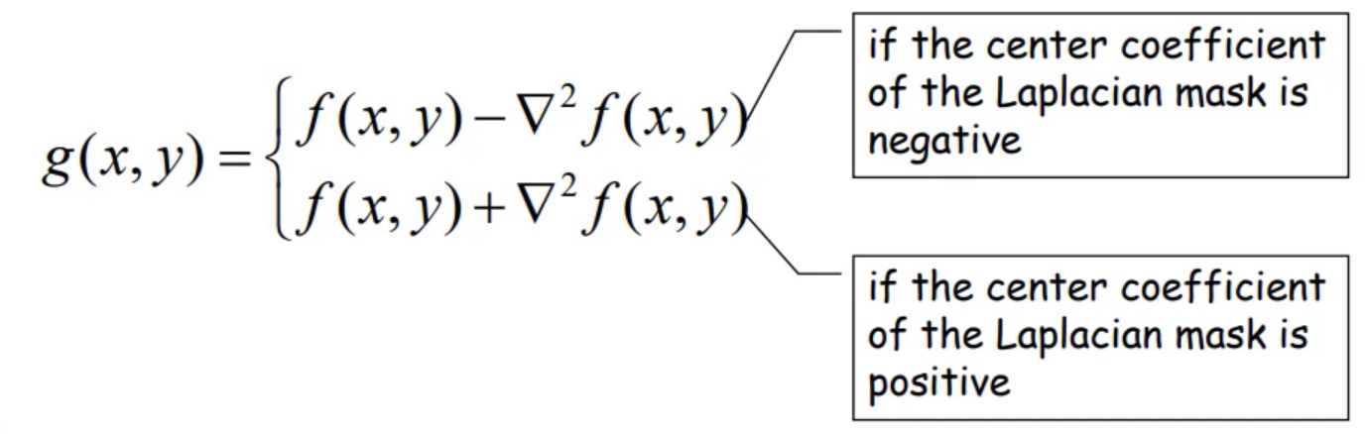
Mathematical representation

Slide 14
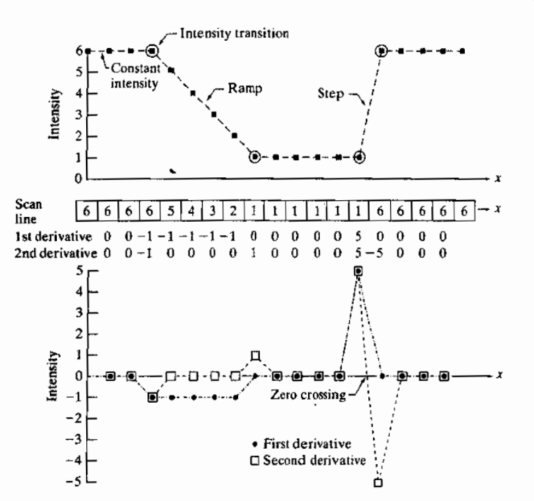
Example

Slide 15
Thank You!!

